Slide 1
SS ZG 566 Secure Software Engineering
T V Rao

Slide 2
Buffer Overflows– Part 1 RL 7.1.1

Slide 3
NIST’s Definition
“A condition at an interface under which more input can be placed into a buffer or data holding area than the capacity allocated, overwriting other information. Attackers exploit such a condition to crash a system or to insert specially crafted code that allows them to gain control of the system.”

Slide 4
Buffer Overflow: A Well-Known Problem
A very common attack mechanism
from 1988 Morris Worm to Code Red, Slammer, Sasser and many others
Prevention techniques known
Still of major concern due to
legacy of widely deployed buggy code
continued careless programming techniques

Slide 5
Morris worm
One of best known worms
Affected 6,000 computers in 1988; cost $10-$100 M
Released by Robert Morris
Graduate student at Cornell, son of NSA chief scientist
Convicted under Computer Fraud and Abuse Act, sentenced to 3 years of probation and 400 hours of community service
Now a computer science professor at MIT
Worm was intended to propagate slowly and harmlessly measure the size of the Internet. Due to a coding error, it created new copies as fast as it could and overloaded infected machines
The worm propagated thru buffer overflow attack against a vulnerable version of fingerd on VAX system

Slide 6
Buffer Overflow Basics
Caused by programming error
Allows more data to be stored than capacity available in a fixed sized buffer
buffer can be on stack, heap, global data
Overwriting adjacent memory locations
corruption of program data
unexpected transfer of control
memory access violation
execution of code chosen by attacker

Slide 7
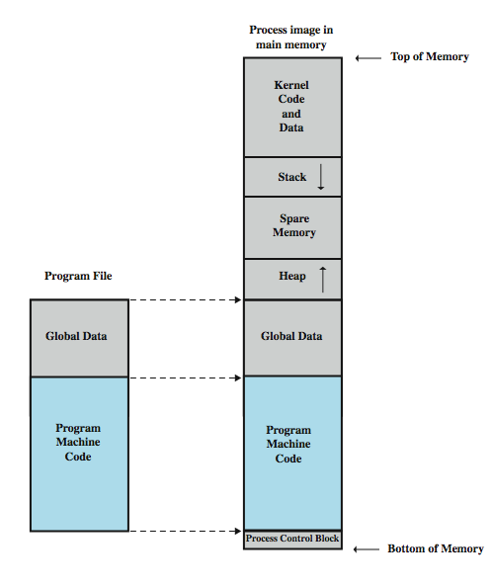
Process in Memory
Processes are divided into three regions: Text, Data, and Stack.
The text region includes code (instructions) and read-only data. This region is normally marked read-only and any attempt to write to it will result in a segmentation violation
The data region contains initialized and uninitialized data. Static variables are stored in this region.
A procedure call alters the flow of control, when finished performing its task, a function returns control to the statement or instruction following the call. This high-level abstraction is implemented with the help of the stack.
The stack is used to dynamically allocate the local variables used in functions, to pass parameters to the functions, and to return values from the function.

Slide 8
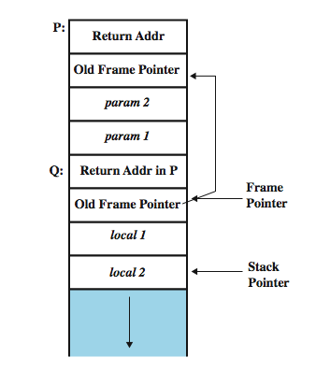
Exploiting the Buffer-Overflow
To fully exploit a stack buffer-overflow vulnerability,
Inject the malicious code: need to be able to inject the malicious code into the memory of the target process. This can be done if attacker can control the contents of the buffer in the targeted program.
Jump to the malicious code: With the malicious code already in the memory, if the targeted program can jump to the starting point of the malicious code, the attacker will be in control.
Stack frame:
Calling function: needs a data structure to store the “return” address and parameters to be passed
Called function: needs a place to store its local variables somewhere different for every call

Slide 9
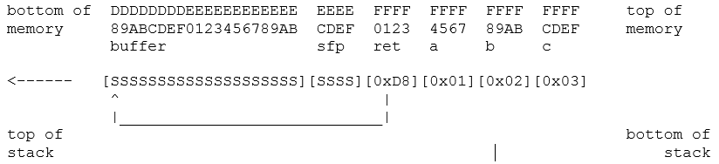
Vulnerable Program
void function(int a, int b, int c) {
char buffer[20];
gets(buffer);
}
void main() {
function(1,2,3);
….
do more
…
}
Assuming the stack starts at address 0xFF, and that S stands for the code attackers want to execute the stack should then look like this:

Slide 10
Arc Injection (return-into-libc)
Arc injection transfers control to code that already exists in the program’s memory space
refers to how exploits insert a new arc (control-flow transfer) into the program’s control-flow graph as opposed to injecting code.
can install the address of an existing function (such as system() or exec(), which can be used to execute programs on the local system
Sophisticated attacks possible using this technique
“Exploit” code pre-installed in code segment; No code is injected
Memory based protection schemes cannot prevent arc injection
Doesn t’ require larger overflows
The original frame can be restored to prevent detection

Slide 11
Thank You!

Slide 12
SS ZG 566 Secure Software Engineering
T V Rao

Slide 13
Buffer Overflow Defenses RL 7.1.2

Slide 14
Buffer Overflow Defenses
Buffer overflows are widely exploited
Large amount of vulnerable code in use
despite cause and countermeasures known
Two broad defense approaches
compile-time - harden new programs
run-time - handle attacks on existing programs

Slide 15
Compile-Time Defenses
Aim to prevent or detect buffer overflows
Possibilities include
Choose a high-level language that does not permit buffer overflows
Encourage safe coding standards
Use safe standard libraries
Include additional code to detect corruption of the stack frame

Slide 16
Compile-Time Defenses: Programming Language
Use a modern high-level languages with strong typing
not vulnerable to buffer overflow
compiler enforces range checks and permissible operations on variables
Flexibility & Safety come with cost in resource use
at compile time
additional checks at run time
Add restrictions on access to hardware
still need some code(e.g. device drivers) in C like languages

Slide 17
Compile-Time Defenses: Safe Coding Techniques
If possible, avoid using potentially unsafe languages e.g. C
Programmer must explicitly write safe code
by design with new code
extensive after code review of existing code, (e.g., OpenBSD)
Buffer overflow safety a subset of general safe coding techniques
Allow for graceful failure (know how things may go wrong)
check for sufficient space in any buffer

Slide 18
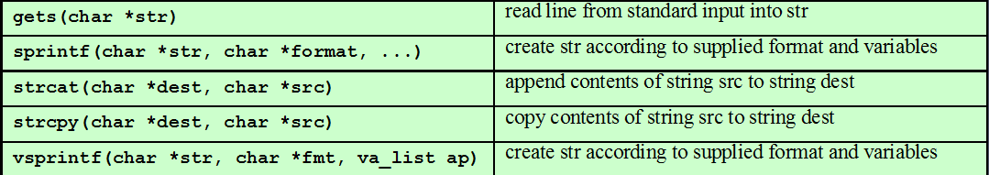
Compile-Time Defenses: Safe Coding Techniques
Common Unsafe C Functions

Slide 19
Compile-Time Defenses: Language Extension, Safe Libraries
Proposals for safety extensions (library replacements) to C
performance penalties
must compile programs with special compiler
Several safer standard library variants
new functions, e.g. strlcpy()
safer re-implementation of standard functions as a dynamic library, e.g. Libsafe

Slide 20
C String Library (SafeStr)
The C String Library (SafeStr) from Messier and Viega provides a rich string-handling library for C that has secure semantics yet is interoperable with legacy library code in a straightforward manner
The SafeStr library uses a dynamic approach for C that automatically resizes strings as required.
SafeStr accomplishes this by reallocating memory and moving the contents of the string whenever an operation requires that a string grow in size.
As a result, buffer overflows should not result from using the library
The SafeStr library uses a dynamic approach for C that automatically resizes strings as required. SafeStr accomplishes this by reallocating memory and moving the contents of the string whenever an operation requires that a string grow in size. As a result, buffer overflows should not result from using the library

Slide 21
Compile-Time Defenses: Stack Protection
Stackguard: add function entry and exit code to check stack for signs of corruption
Use random canary
e.g. Stackguard, Win/GS, GCC
check for overwrite between local variables and saved frame pointer and return address
abort program if change found
issues: recompilation, debugger support
Or save/check safe copy of return address (in a safe, non-corruptible memory area), e.g. Stackshield, RAD (Return Address Defender)

Slide 22
Run-Time Defenses: Non Executable Address Space
Many BO attacks copy machine code into buffer and xfer ctrl to it
Use virtual memory support to make some regions of memory non-executable (to avoid exec of attacker’s code)
e.g. stack, heap, global data
need h/w support in MMU
long existed on SPARC/Solaris systems
recent on x86 Linux/Unix/Windows systems
Issues: support for executable stack code

Slide 23
Run-Time Defenses: Address Space Randomization
Manipulate location of key data structures
stack, heap, global data: change address by 1 MB
using random shift for each process
have large address range on modern systems means wasting some has negligible impact
Randomize location of heap buffers and location of standard library functions

Slide 24
Run-Time Defenses: Guard Pages
Place guard pages between critical regions of memory (or between stack frames)
flagged in MMU (mem mgmt unit) as illegal addresses
any access aborts process
Can even place between stack frames and heap buffers
at execution time and space cost

Slide 25
Source Code Analysis Tools
Source Code Analysis Tools (security analyzers ) are automated tools for helping analysts find security-related problems in software
use data- and control-flow analysis to find subtler bugs and to reduce false alarms
Some vulnerabilities (e.g. use of strcpy() ) can be detected with high accuracy, others are harder to detect, and, in fact, one can always devise vulnerabilities that are undetectable altogether.
Tools have tradeoff between false alarms (also known as false positives) and missed vulnerabilities (also known as false negatives)
can be configured to make a tool more sensitive (decreasing false negatives while increasing false positives) or make it less sensitive (increasing false negatives while decreasing false positives)

Slide 26
Thank You!

Slide 27
SS ZG 566 Secure Software Engineering
T V Rao

Slide 28
Heap & Integer Vulnerabilities RL 7.2.1

Slide 29
Heap Overflow
Possible to attack buffer located in heap
typically located above program code and global data and grows up in memory (while stack grows down towards it)
memory requested by programs to use in dynamic data structures, e.g. linked lists
No return address
hence no easy transfer of control
May have function pointers that can be exploited
Typically for custom processing of data, e.g. decoding a compressed image
or manipulate management data structures
Defenses: non executable or random heap

Slide 30
Heap Overflow Example

Slide 31
Integer Security
Integers represent a source of vulnerabilities in C and C++ programs.
Integer range checking has not been systematically done in many C and C++ software
Security flaws involving integers exist
Some of these are likely to be vulnerabilities
Integers in C and C++ are either signed or unsigned.
For each signed type there is an equivalent unsigned type.
Signed integers are used to represent positive and negative values.
On a computer using two’s complement arithmetic, a signed integer ranges from -2^{n-1} through 2^{n-1}-1.
Unsigned integer values range from zero to a maximum
This maximum value can be calculated as 2^{n-1}, where n is the number of bits used to represent the unsigned type.

Slide 32
Integer Conversions
Type conversions may occur in C and C++
explicitly as a cast or
implicitly as C language can perform operations on mixed types.
Conversions can lead to lost or misinterpreted data.

Slide 33
Integer Conversions

Slide 34
Conversion anomaly
#define BUFF_SIZE 10
int main(int argc, char* argv[]){
int len;
char buf[BUFF_SIZE];
len = atoi(argv[1]);
if (len < BUFF_SIZE) {
memcpy(buf, argv[2], len);
}
}
unsigned int n = ULONG_MAX;
char c = -1;
if (c == n) {
printf(“-1 = 4,294,967,295 ?\n”);
}

Slide 35
SafeInt Class
SafeInt is a C++ template class written by David LeBlanc.
Implements a precondition approach that tests the values of operands before performing an operation to determine if an error will occur.
The class is declared as a template, so it can be used with any integer type.
Every operator has been overridden except for the subscript operator[]

Slide 36
Thank You!

Slide 37
SS ZG 566 Secure Software Engineering
T V Rao

Slide 38
Format String Vulnerabilities RL 7.2.2

Slide 39
Format Strings
Printf (stands for "print formatted") format string are control parameter used by a class of functions in the string-processing libraries.
The format string is written in a simple template language, and specifies a method for rendering an arbitrary number of varied data type parameters into a string
e.g.
printf ("a has value %d, b has value %d, c is at address: %08x\n", a, b, &c);

Slide 40
Format Strings Abuse
Consider e.g.
printf ("a has value %d, b has value %d, c is at address: %08x\n", a, b);
Here the format string asks for 3 arguments, but the program actually provides only two (i.e. a and b). This program passes the compiler.
The function printf() is defined as function with variable length of arguments. Therefore, by looking at the number of arguments, everything looks fine.
To find the miss-match, compilers needs to understand how printf() works and what the meaning of the format string is. However, compilers usually do not do this kind of analysis.
Sometimes, the format string is not a constant string, it is generated during the execution of the program. Therefore, there is no way for the compiler to find the miss-match in this case.

Slide 41
Format Strings Abuse
The function printf() fetches the arguments from the stack. If the format string needs 3 arguments, it will fetch 3 data items from the stack.
In a mis-match case, it will fetch some data that do not belong to this function call.
Crashing the program
printf ("%s%s%s%s%s%s%s%s%s%s%s%s");
For each %s, printf() will fetch a number from the stack, treat this number as an address, and print out the memory contents pointed by this address as a string, until a NULL character (i.e., number 0, not character 0) is encountered.
Since the number fetched by printf() might not be an address, the memory pointed by this number might not exist, if so the program will crash.
It is also possible that the number happens to be a good address.

Slide 42
Format Strings Abuse
Viewing the stack
printf ("%08x %08x %08x %08x %08x\n");
This instructs the printf-function to retrieve five parameters from the stack and display them as 8-digit padded hexadecimal numbers.
So a possible output may look like:
40012980 080628c4 bffff7a4 00000005 08059c04
Consider the program
int main(int argc, char *argv[])
{ char user_input[100];
... ... /* other variable definitions and statements */
scanf("%s", user_input); /* getting a string from user */
printf(user_input); /* Vulnerable place */
return 0;
}
If the attacker provides user input of "\x10\x01\x48\x08 %x %x %x %x %s" , the program will print contents at the address 0x10014808

Slide 43
Format Strings Abuse
Writing an integer in the process memory
%n: The number of characters written so far is stored into the integer indicated by the corresponding argument. Consider the code that writes 5 to i:
int i;
printf ("12345%n", &i);
Using the same approach as that for viewing memory at any location, we can cause printf() to write an integer into any location. Just replace the %s in the previous example with %n, and the contents at the address 0x10014808 will be overwritten.

Slide 44
Format Strings Abuse
Using this attack, attackers can do the following:
Overwrite important program flags that control access privileges ∗ Overwrite return addresses on the stack, function pointers, etc.
However, the value written is determined by the number of characters printed before the %n is reached.
Is it really possible to write arbitrary integer values?
Use dummy output characters. To write a value of 1000, a simple padding of 1000 dummy characters would do.
To avoid long format strings, we can use a width specification of the format indicators.

Slide 45
Thank You!

Slide 46
SS ZG 566 Secure Software Engineering
T V Rao

Slide 47
Java Security RL 7.3.1

Slide 48
Inherent Java Security
The Java language is designed keeping security in mind.
Every entity has an associated Access Level:
Public, Protected, Default/Package, Private
Provides encapsulation
A strongly typed language:
Restrictions on how data types can be mixed
No direct memory access
No notion of pointers
Entities are accessed via references (by name)
Variables must be initialized before they are used
Objects can’t be arbitrarily cast into other objects (ensures a type safe environment):
Strict use of extends, implements (inheritance)
Compile time type checking of casting
Provides automatic memory management, garbage collection, and array range-checking

Slide 49
The Java Runtime Environment (JRE)
Consists of the Java Virtual Machine (JVM) and Class Libraries
JVM: available for most platforms, provides the environment for java bytecode to execute
Offers Platform Independence: “Write once, run anywhere!”
Is an abstract virtual machine
Diff. implementations: Sun, IBM, Oracle, MS
Each thread has its own stack
Typical instruction set: Load/Store, Arithmetic, etc.
Interprets bytecode generated by Java compilers
Class Libraries: The Core Java API, contains classes for language support and added functionality

Slide 50
Why Java Needs Security
Source
Code
Web Server
Byte
Code
Web Browser
Internet
Compiler
JVM
External Control over System Resources
Local System
Resources

Slide 51
Bytecode Verifier
When a class loader presents the bytecodes of a newly loaded class to JVM, these bytecodes are first inspected by a Verifier.
All classes except for system classes are verified; but verification can be deactivated with undocumented –noverify option
Here are some of the checks that the verifier carries out:
Variables are initialized before they are used.
Method calls match the types of object references.
Rules for accessing private data and methods are not violated.
Local variable accesses fall within the runtime stack.
The runtime stack does not overflow.
If any of these checks fails, then the class is considered corrupted and will not be loaded
A class file generated by a compiler for the Java programming language always passes verification. However, the bytecode can be changed by someone with some experience in assembly programming and a hex editor to manually produce a class file that contains valid but unsafe instructions for the Java virtual machine

Slide 52
Class Loader
A Java compiler converts source instructions into bytecode for the Java virtual machine.
Each class file contains the definition and implementation code for one class or interface. These class files must be interpreted into the machine language of the target machine.
The virtual machine loads only those class files that are needed for the execution of a program.
The class loading mechanism doesn't just use a single class loader, has at least three class loaders:
The bootstrap class loader : loads the system classes, typically from rt.jar; integral part of the JVM; usually implemented in C
The extension class loader : loads "standard extensions" from jre/lib/ext directory; will find the classes in them, even without any class path
The system class loader (also sometimes called the application class loader) : loads the application classes. It locates classes in the directories and JAR/ZIP files on the class path (CLASSPATH environment variable or –classpath option)
In Sun's Java implementation, the extension and system class loaders are implemented in Java

Slide 53
Java Security Sandbox
The base Java Security sandbox is comprised of three major components: the byte code Verifier, the Class Loader, and the Security Manager.
The Security Manager depends on Class Loaders to correctly label code as trusted or untrusted. Class Loaders also shield the Security Manager from spoofing attacks by protecting local trusted classes making up the Java API.
On the other hand, the class loader system is protected by the Security Manager, which ensures that an applet cannot create and use its own Class Loader.
The Verifier protects both the Class Loaders and the Security Manager against language-based attacks meant to break the VM. All in all, the three parts intertwine to create a default sandbox.
However, the three parts are not created or specified by a standards committee.
Java applications, including Java-enabled Web browsers, are allowed to customize two of the fundamental portions of the security model to suit their needs (the Class Loader and the Security Manager).
A great deal of faith is placed in the ability of VM implementations to ensure that untrusted code remains properly contained. Bugs in the system will compromise the entire security model.

Slide 54
Java Security Weaknesses
Fine-grained control with a lot of complexity. Learning curve for developers
Relies on user to secure their own environment via a complex Policy Tool
Multiple JVM Implementations: each have their own unique vulnerabilities
Reverse engineering of class files to source code(software watermarking, code obfuscation can not be security)
Several flaws have been addressed over the evolution of Java and the JVM

Slide 55
(Some) Java Security Guidelines
Java offers several ways to allocate uninitialized objects. The easy way to protect yourself against this problem is to write your classes so that before any object does anything, it verifies that it has been initialized.
If a class or method is non-final, an attacker could try to extend it in a dangerous and unforeseen way. Make something non-final only if there is a good reason, and document that reason.
Do not depend on package scope - Classes, methods, and variables, by default, are accessible within the same package. Sometimes an attacker could introduce a new class inside the package, and use this new class to access the things programmer thought hidden
Java language allows inner classes (class within class). Java byte code has no concept of inner class, so it becomes ordinary class in the package. Further inner class has privilege to access private members in the containing class.
Securing Java by Gary McGraw, Ed Felten, John Wiley

Slide 56
(Some) Java Security Guidelines
Make Your Classes Uncloneable – Cloning creates new instances without executing constructor. If you must permit cloning, make the clone method final.
attacker can define a subclass of your class, and make the subclass implement java.lang.Cloneable. You can prevent subclass cloning by defining the following method in each of your classes:
public final void clone() throws java.lang.CloneNotSupportedException {
throw new java.lang.CloneNotSupportedException();
}
Make Your Classes Unserializeable - Serialized classes expose internal dynamic state of objects in byte code format to an attacker.
Make Your Classes Undeserializeable - Even if a class is not serializeable, it may be deserializeable. An adversary can create a sequence of bytes that happens to deserialize to an instance of your class, and you do not have control over what state the deserialized object is in.
Securing Java by Gary McGraw, Ed Felten, John Wiley

Slide 57
Computer Security: Principles and Practice by William Stallings, and Lawrie Brown Pearson, 2008.
www.us-cert.gov/bsi
sei.cmu.edu/cert
www.owasp.com
www.cigital.com

Slide 58
Thank You!

